Slide 1
install Visual C++ 6
Write a program in VC6
Course Instructor: Md.Shamsujjoha

Slide 2
Installing Visual C++ 6
Step 1: Find the installer “Visual Studio 6”
Step 2: Find the file “setup.exe”
Step 3: Run this program.

Slide 3
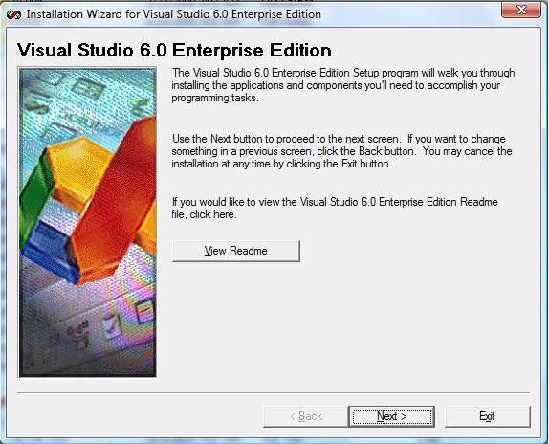
Step 4
Press Next

Slide 4
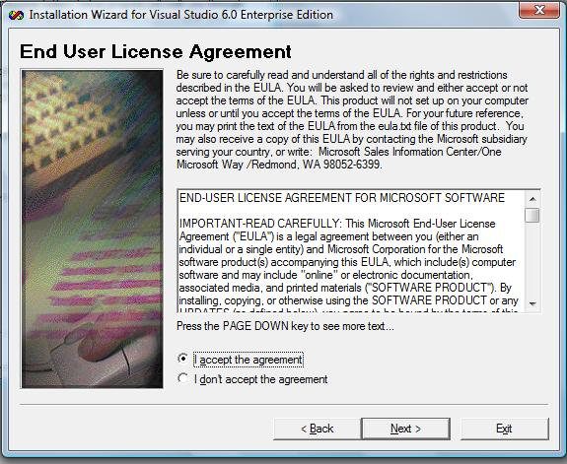
Step 5
Select: “I accept the agreement”
Press Next

Slide 5
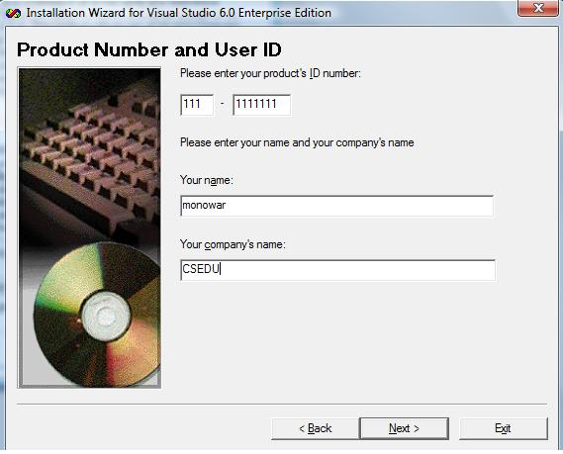
Step 6
Product ID Number:
  *** – *******
Your name: …
Your Company name: …
Press Next

Slide 6
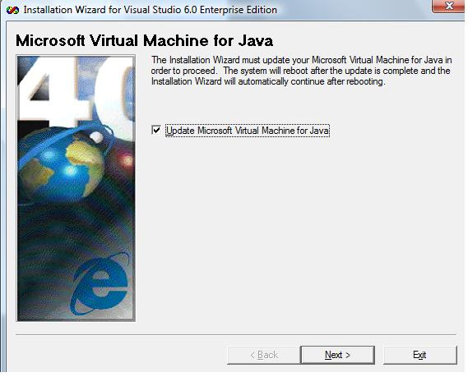
Step 7
Tick “Update Microsoft Visual Machine for Java
Press Next
After completing this part, the computer will be restarted.

Slide 7
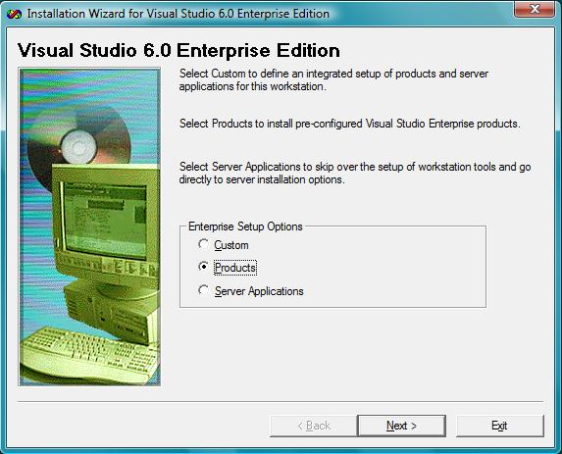
Step 8
After restart the computer you will find this window.
Select “Products”
Press Next

Slide 8
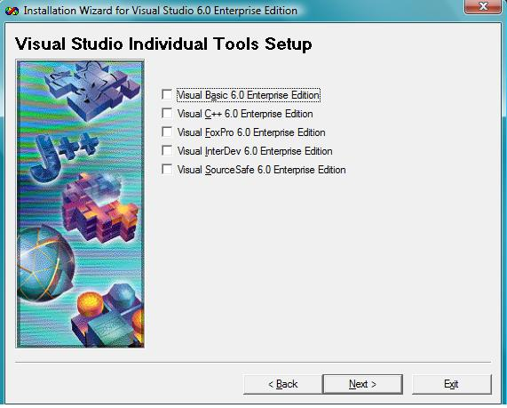
Step 9
Select “Visual C++ 6.0 Enterprise Edition”
Press Next
Step 10: Next Window ->Press Continue
Step 11: Next Window -> Press Ok
Step 12: Press “Yes” for VSS option

Slide 9
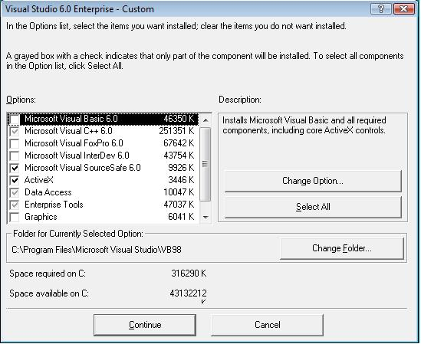
Step 13
Press “Continue”

Slide 10
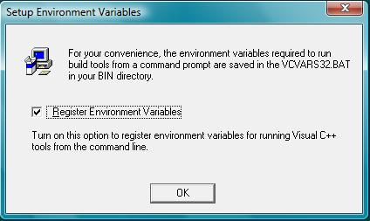
Step 14: (Important)
Select “Register Environment Variables”
Press OK
Now “Visual C++ 6” will be installed in your computer.
After installation, the computer will be restarted.

Slide 11
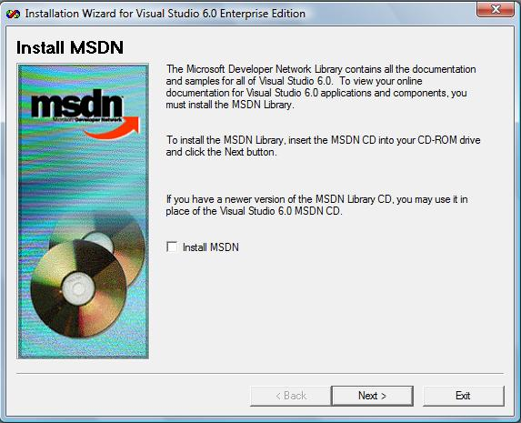
Step 15
After restart, there will be an option to install MSDN (help file for VISUAL C++). Select it if you have MSDN CD, or ignore it. You can install it later.

Slide 12
Step 16
Don’t select “Install Shield”, Press “next”
Don’t select anything in next window, Just Press “next”
Tick off “Register Now” and press “Finish” . It is not required to register the software. So avoid this at this time.
Now VISUAL C++ 6 is ready

Slide 13
Write your First Program in Visual C++ 6

Slide 14
Step 1:
Create a directory named “code” in “c:\” directory using “windows explorer”

Slide 15
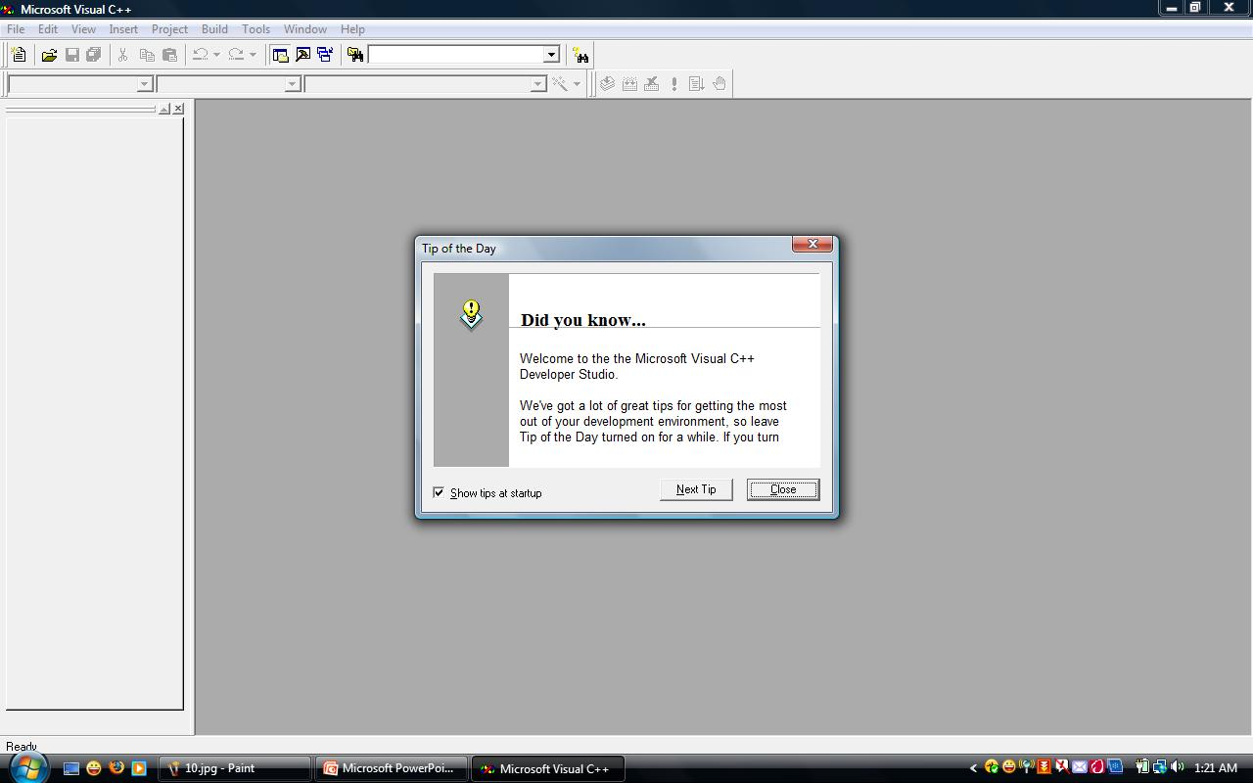
Step 2
Run the program “Microsoft Visual C++ 6” from “All Program”

Slide 16
Step 3:
Click “File” -> “New”
Select “Files” ->”C++ Source File”
Type “first.c” in the “File name” option
Location should be “c:\code\”
Click “ok”

Slide 17
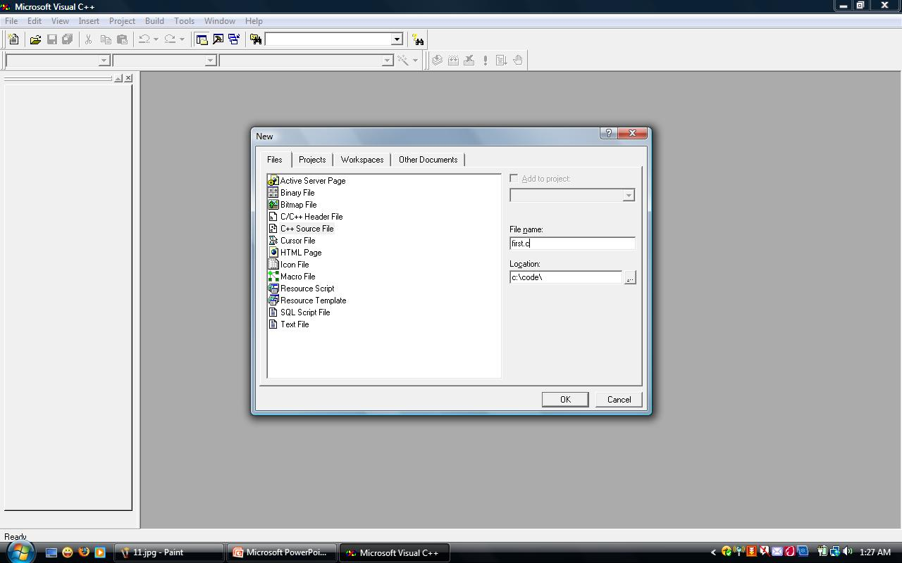
Step 3 (continue):

Slide 18
Step 4:
Write the following code and save it.
#include <stdio.h>
int main()
{
printf("My First Program\n");
return 0;
}

Slide 19
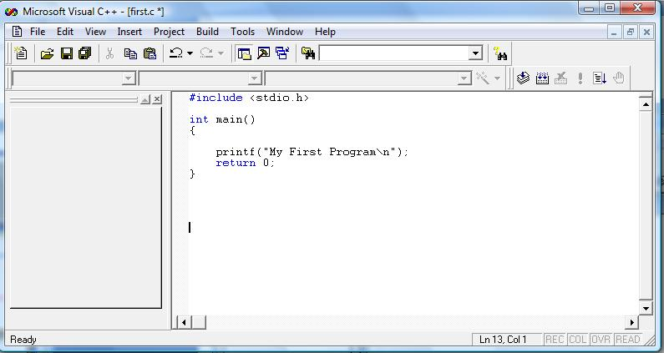
Step 4 (Continue):

Slide 20
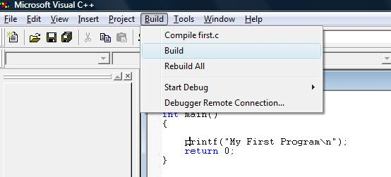
Step 5
Select “Build” -> “Compile first.c” option from the menu.

Slide 21
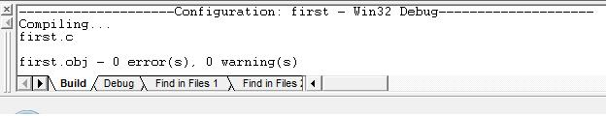
Step 6
Check the error from the bottom part of the window. If there are errors, check the code again. There must be some error in the code. If there is no error, you can proceed to the next slide.

Slide 22
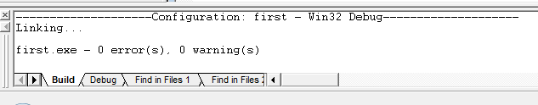
Step 6:
Select “Build” -> “Build first.exe” from the menu.
After selecting this, the bottom part of the window looks like above (no errors)

Slide 23
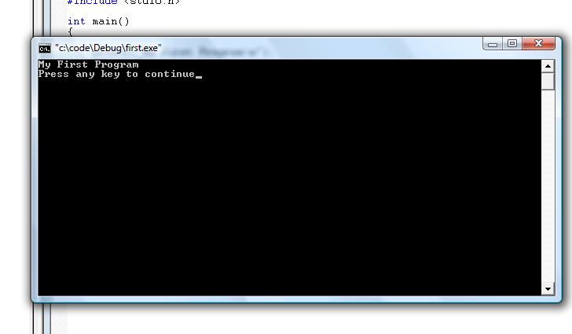
Step 7
Select “Build” ->”Execute “First.exe” from the menu and check the result. (A black window where “My First Program” will be shown)

Slide 24
We are done

